Slide 1



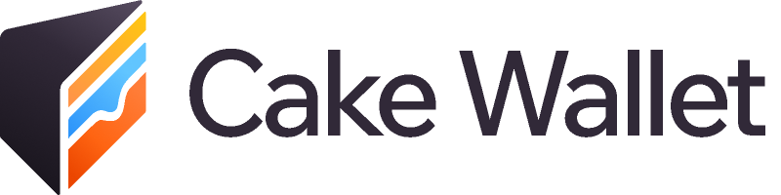
Spark and Ark:
the good, the bad, and the ugly
Notes:
Quick intro: been deep down the rabbit hole of both Spark and Ark looking for the best way to bring user-friendly, non-custodial Lightning to Cake Wallet users. This talk is the distilled version of that research - what these protocols actually are, who you're trusting, and what your privacy looks like in practice.

Slide 2

Why do we need new layer twos?
Run Lightning yourself…
…or hand over your keys
• Inbound liquidity gymnastics
• Custodial “Lightning” wallets
• Always-online requirement
or
• Their keys, their rules
• Channel management on a phone
• Censorship and seizure risk
• On-chain fees for every channel
• Not bitcoin — an IOU
Spark and Ark are the first credible attempts to break this tradeoff
Notes:
Until now Lightning forced a choice. Run it yourself: inbound liquidity, channel management, being always online - next to impossible on a phone, especially iOS. Or hand your keys to a custodian and get great UX that isn't bitcoin anymore. Lightning's biggest realization: its best role is connecting things together - plumbing - not being run directly by your grandma on her phone. Spark and Ark exist to break this tradeoff: self-custodial payments with custodial-grade UX, and both intend to go well beyond payments.

Slide 3
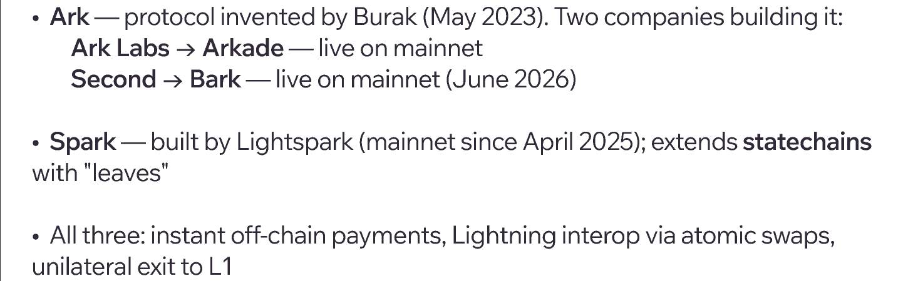
The contenders
Notes:
Key framing for the whole talk: 'Ark' is not one network. Arkade and Bark share a protocol ancestor but have diverged in terminology, mechanisms, and shipping status - though as of June 9, 2026 BOTH are now live on mainnet. Spark is a different beast entirely - statechain lineage, not Ark lineage.

Slide 4
Key terms
Ark speak
Spark speak
VTXO — a Bitcoin UTXO that lives off-chain
Leaf — Spark's off-chain coin; splits to any amount
Operator — co-signs everything, fronts the liquidity
Spark Operators — Lightspark, Breez, Flashnet (2-of-3 FROST signing)
Round / batch swap — trade VTXOs for new ones, fully anchored on-chain
Spark Service Provider (SSP) — the bridge between leaves and Lightning
Expiry — refresh ~monthly or the operator can sweep your coins
Out-of-round — instant payment; trust-minimized, not final
Notes:
One slide of vocabulary, then we're done with definitions. Ark: virtualized UTXOs with an operator in the middle and an expiry clock - those two facts drive every tradeoff coming up. Spark: statechains 101 - a 2-of-2 between you and the operators, transferred by re-tweaking the operators' key and deleting the old share; leaves mean you're not stuck transferring whole UTXOs. Note the operator set grew from 2 to 3 since my article (Breez joined Lightspark and Flashnet). Double-spending requires operators retaining old keys AND collusion with a previous sender - both have to fail.

Slide 5
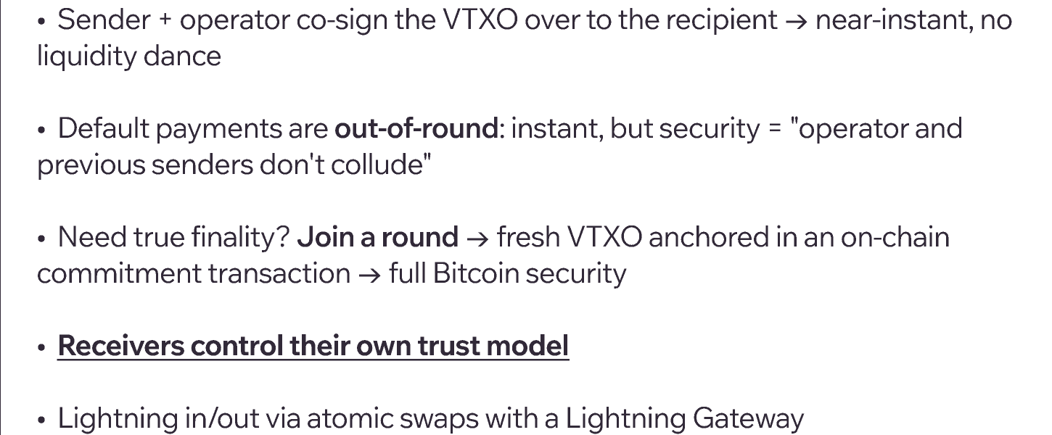
How Ark works
Notes:
Receivers control their own trust model - that's the elegant part. Small coffee payment? Accept it out-of-round and move on. Just got paid your salary? Join a round and get on-chain finality. The round costs time (operator-dependent cadence, minutes to hours) and a fee, but it's AVAILABLE - remember this for the Spark comparison.

Slide 6
Ark is not unified
Arkade (Ark Labs)
Bark (Second)
Status
✅ Mainnet, live
✅ Mainnet — live (June 2026)
Direction
Programmable execution layer: contracts, assets, the Virtual Mempool
Payments-focused wallet SDK: Ark + Lightning + on-chain
Vocabulary
“batch swap”, “commitment tx”, “Arkade tx”
“rounds”, “arkoor”, “round tx”
Refresh
Intent delegation — shipped
hArk non-interactive rounds — shipped; delegated co-signers WIP
Notes:
Same ancestor, genuinely different projects now - and as of June 2026 both are on mainnet. Arkade has even deprecated half the original Ark vocabulary. Ark Labs is going broad - smart contracts, assets, an execution environment. Second is going deep on doing payments extremely well, shipping the Bark SDK, Barkd daemon, and day-one app integrations. Don't let anyone tell you 'Ark does X' without asking WHICH Ark.

Slide 7
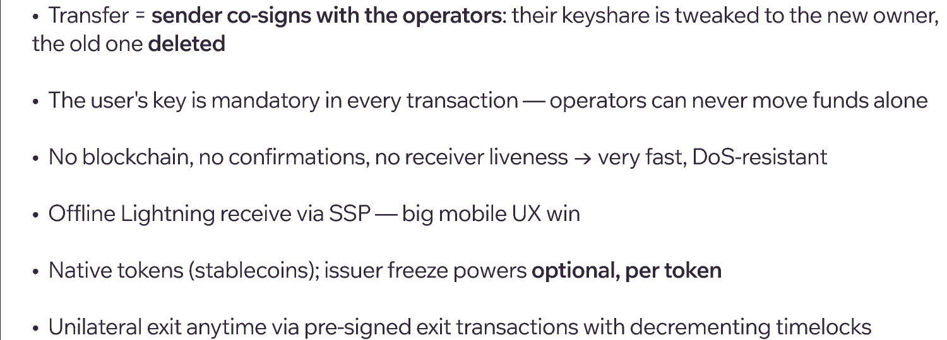
How Spark works
Notes:
Spark's pragmatism shows here: no rounds, no liveness requirements, offline receive that actually works on iOS. Emphasize the sender is an active participant - this is a co-signing protocol, not operators shuffling funds on their own. The price: you can never PROVE the old key was deleted. Security holds if an operator deleted or the previous sender is honest - but it's faith-based, not provable. We'll dig into that next.

Slide 8
Problem: expiry
VTXOs expire (~28–30d) so operators can reclaim liquidity. Miss the window → the operator can sweep your funds. Phones can't guarantee being online.
Solution
Status
Tradeoff
Arkade
Intent delegation: pre-signed intents let one or more delegates refresh for you — no key handoff, 1-of-N honest is enough
✅ Shipped
Delegated renewals stay in preconfirmation — no Bitcoin finality unless you settle yourself
Second
hArk non-interactive rounds: participants claim asynchronously; delegated refresh APIs
✅ hArk shipped
⚠️ co-signers WIP
Until co-signers ship, delegated refresh trusts the server alone during the round
Spark
No expiry at all — relative timelocks only decrement on transfer; no deadline while holding
N/A
Trades the expiry problem for the unprovable key-deletion problem
Notes:
This is where Ark's biggest UX wart lives, and both teams know it. Arkade's delegation is the most complete answer shipped today: multiple delegates, 1-of-N honest is enough, delegates can't steal or alter anything. Second's hArk removed the 'everyone online at once' requirement, but their trust-minimized co-signer set is explicitly post-mainnet. And the honest punchline: a covenant soft fork (CTV/TEMPLATEHASH) would make most of this complexity evaporate.

Slide 9

Problem: finality
Instant off-chain payments can't have on-chain finality by default. Who can double-spend you — and can you upgrade to true finality?
Solution
Status
Tradeoff
Arkade
Two explicit tiers: preconfirmation (trust the operator won't double-sign) → batch swap = full Bitcoin finality on demand
✅ Shipped
(mainnet)
Finality is interactive — you must join the batch swap yourself; delegates can't get it for you
Second
All payments are arkoor (trust: sender + server don't collude); refresh converts to a trustless in-round VTXO
✅ Shipped
(mainnet)
No in-round payments — finality always costs a round + on-chain confirmations
Spark
Funds are safe if an operator deleted the old keyshare — or the previous sender stays honest
⚠️ Inherent —
never provable
If all operators retain keys and collude with a previous sender, leaves can be double-spent; deletion is unverifiable
Notes:
The cleanest way I've found to put it: in Ark, finality is AVAILABLE but interactive. In Spark, finality is ASSUMED but unprovable. For everyday amounts, Spark's assumption across Lightspark, Breez, and Flashnet is honestly reasonable. For life savings, 'trust me, I deleted it' is not a security model - and Spark themselves are candid about this in their docs.

Slide 10
Problem: privacy
None of these are privacy protocols — the operator co-signs and sees everything. The question is what happens to that data.
Today
Future improvements
Arkade
VPN model — the operator sees your transactions
None firmly proposed
Second
VPN model — server sees all transaction details; Tor + no key reuse shipped
None firmly proposed
Spark
VPN model — server sees all transaction details, but doesn’t publish them
Confidential amounts on token transfers (WIP)
Notes:
The VPN analogy is the one to land: off-chain does not mean private; it just moves visibility from the public blockchain to a third party who promises (or doesn't) to behave. Today: Spark's Privacy Mode (default in Cake, now Wallet of Satoshi) keeps history off public explorers, but it's visibility filtering by operators, not cryptography. Looking forward: neither Ark implementation has firmly proposed privacy tech - the blinded-credential ideas from 2025 never entered Arkade's docs, and Second has nothing on the roadmap (covenants could unlock private rounds someday). Spark is the only one with announced privacy work: confidential amounts on token transfers and blind signing - announced Sept 2025, still WIP, not yet in their docs (their docs privacy page is literally an empty stub).

Slide 11
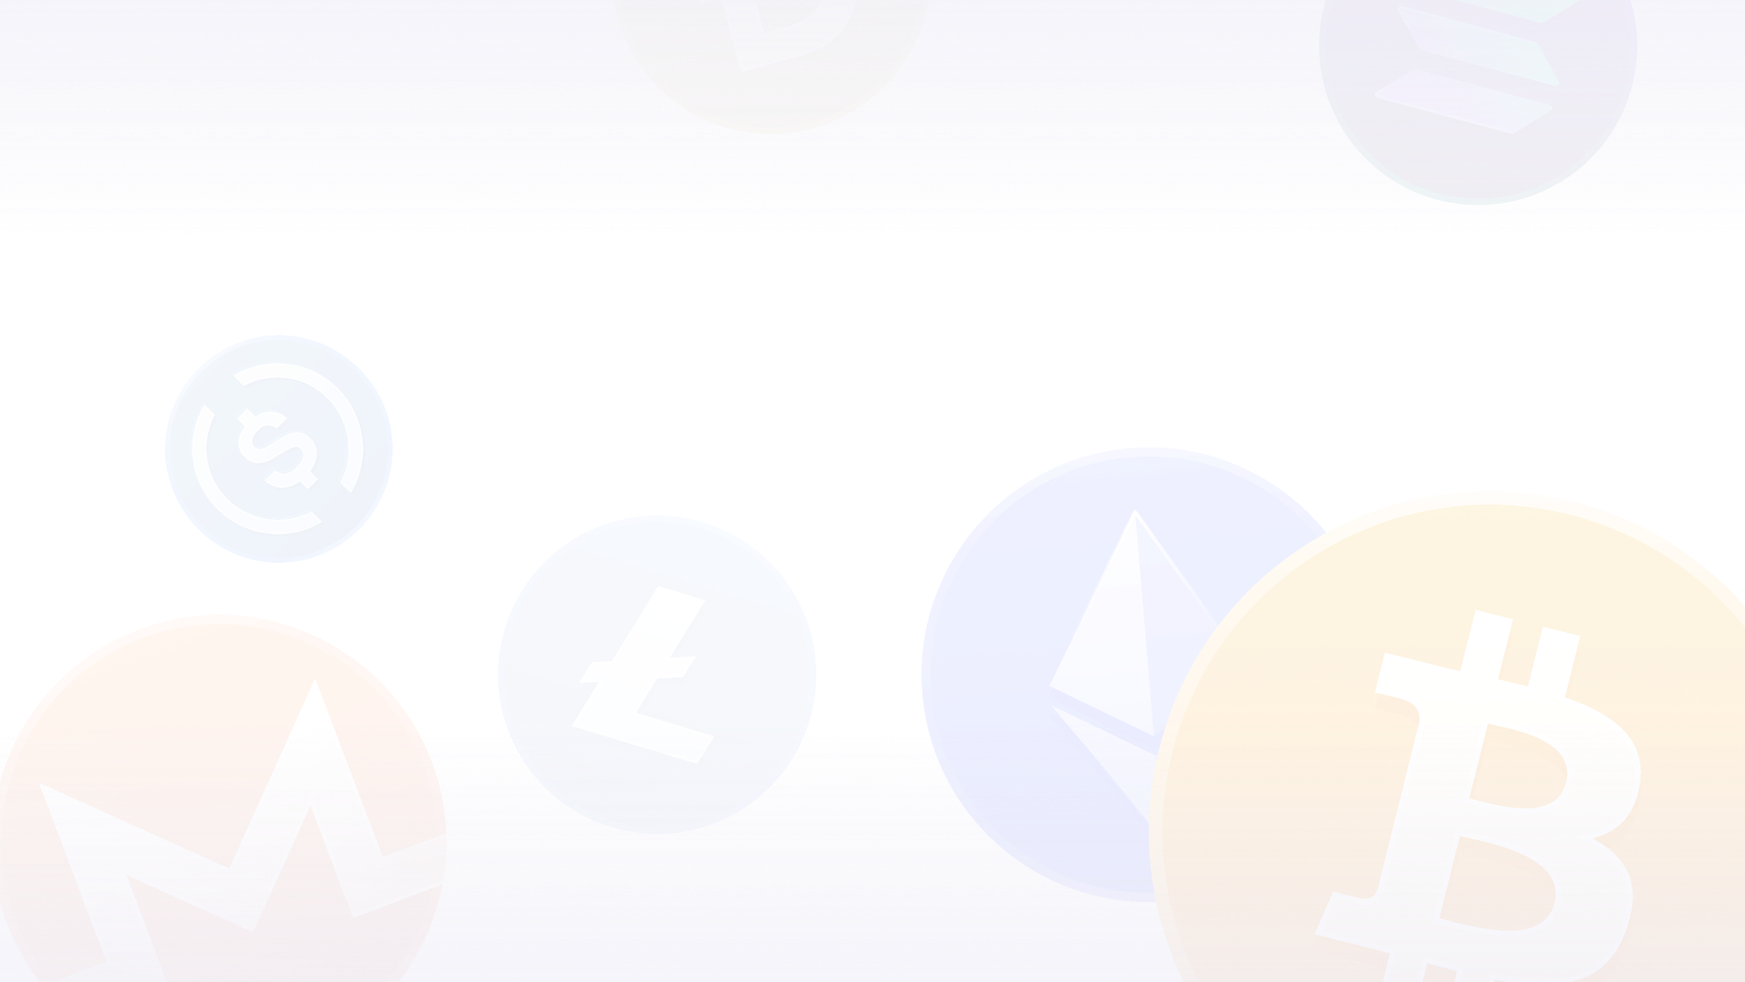
Meet Alice
Mobile wallet · no node · no server · delegates everything · mostly offline
Notes:
This is the scenario that actually matters - not the protocol whitepaper's idealized always-online user. ~99% of users look like Alice. Walk through each system from her seat.

Slide 12
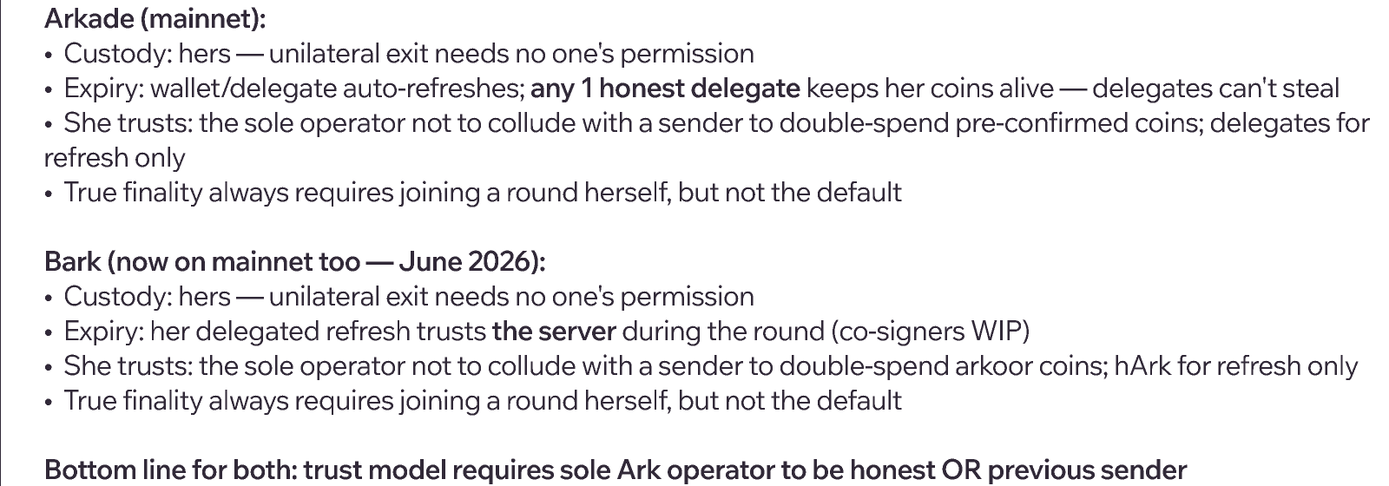
Alice on Ark
Notes:
Net: Alice on Ark holds real, exit-enforceable coins with a maintenance requirement - like a garden that needs watering, and she can hire multiple gardeners who are physically unable to steal the vegetables. Bark just went live on mainnet (June 9, 2026) alongside the SDK, Barkd, and several apps (Noah, Arke, Satsigner, Bark Wallet, a BTCPay plugin). The finality caveat holds: nothing a delegate does gives her true finality; that always requires her own participation. Bark exit math: log4 tree, e.g. a 256-user round = 5 txs, plus ~10h CSV.

Slide 13
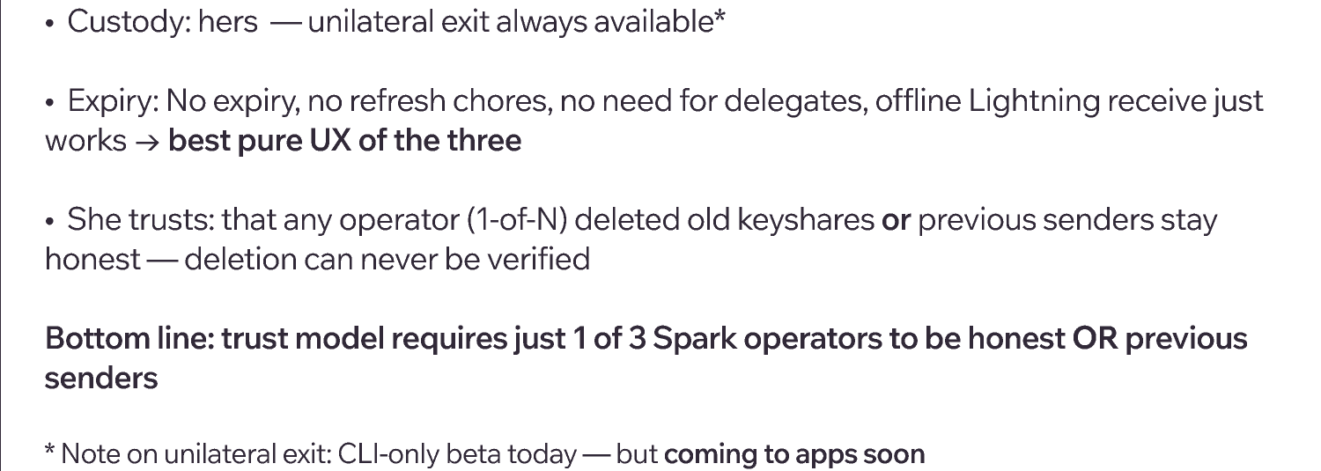
Alice on Spark
Notes:
Spark made Alice's daily life easiest and her sovereignty haziest. Offline receive and zero maintenance are exactly what mobile needs. But her safety rests on unverifiable deletion by 3 permissioned companies plus honest previous senders, and her practical ability to exit unilaterally is limited today - though in-app unilateral exit is on its way, which will close a real gap. Privacy in practice is decent now that major wallets ship with Privacy Mode on - but it's the VPN model, not cryptographic privacy.

Slide 14
The custody spectrum
On-chain Bitcoin
Lightning via LSP
Spark
Fedimint
Custodians
Self-hosted LN node
Ark
Liquid
Cashu
← Self-custodial
Custodial →
Notes:
Zoom all the way out. Nothing here is binary - custody is a spectrum, and every project on this slide is a different point on it. Ark and Spark sit closer to the self-custodial end than almost anything else that gives you this UX - that's the achievement. But don't confuse them with on-chain Bitcoin, and don't let anyone sell them as equivalent to a custodian either.

Slide 15
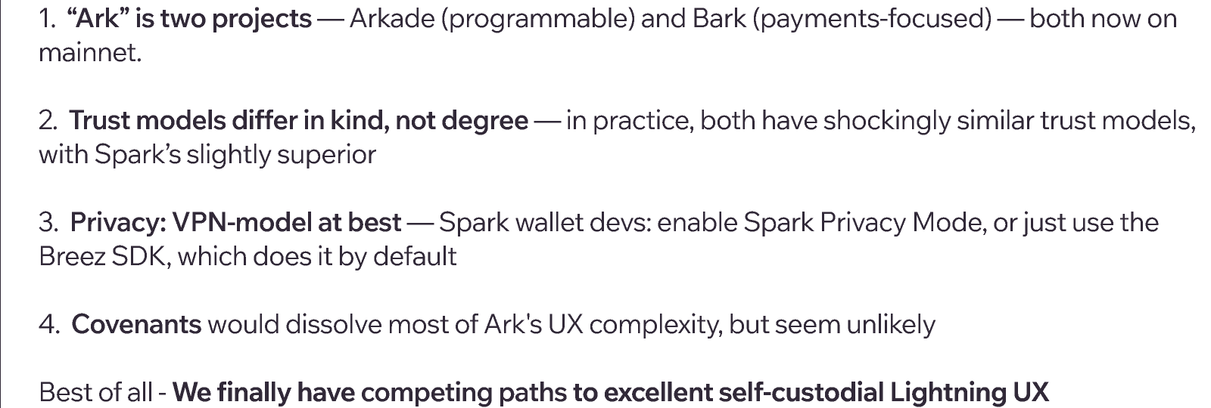
Takeaways
Notes:
End on the optimistic note from the article's conclusion: neither is perfect, both are pragmatic, and wallet developers finally have real options that don't force custodial Lightning. The tradeoffs are real but improving fast - these are rapidly evolving protocols.

Slide 16

Thank you
“Spark and Ark: A Look At Our Newest Bitcoin Layer Twos” — bitcoinmagazine.com
docs.arkadeos.com · second.tech/docs · docs.spark.money
@sethforprivacy · cakewallet.com
Notes:
Q&A.

